Slide 1

Demand Forecasting By Manufacturing Companies
Prabesh Adhikari
Sandhya K.C.

Slide 2

GoldStar Shoes
ABOUT
Panchakanya Group
Himalaya Craft

Slide 3

COMPANY OVERVIEW
GoldStar Shoes

Slide 4

GoldStar Footwear
ESTABLISHMENT
MAJOR INVESTMENT
Mid-1970s
Research and Development
KEY FEATURES
USABILITY
Comfortable, Durable and Affordable
Customers want something that’s easy to adopt and simple to use
GROWTH
30%-35% Annual

Slide 5

Demand Forecasting
Sales Team
Historical Data
Dealer’s Data
SAP Software – ERP Software
Market Intelligence

Slide 6

BUSINESS MODEL
R & D
ABSTRACT
SEGMENTS
Huge amount of investment is on Research and Development
Implementation of MRP and BE
MRP - Material Resource Planning
BE – Business Intelligence
PVC – Material with Thermal Stability
PU – High Quality and Safety Shoes
G10 – Rubber Closure

Slide 7

PRODUCT OVERVIEW
UNIQUE
TESTED
Only product specifically dedicated to investment tools for business
Conducted testing with businesses in the area
FIRST TO MARKET
AUTHENTIC
First beautifully designed product that's both stylish and functional
Designed with the help and input of investment experts in the field

Slide 8

Panchakanya Group
ESTABLISHED IN 1971
FOCUSES ON HIGH-PROFILE CUSTOMER
PRODUCTION ONLY ON ORDER
MISSION FOR CUSTOMER SATISFACTION

Slide 9
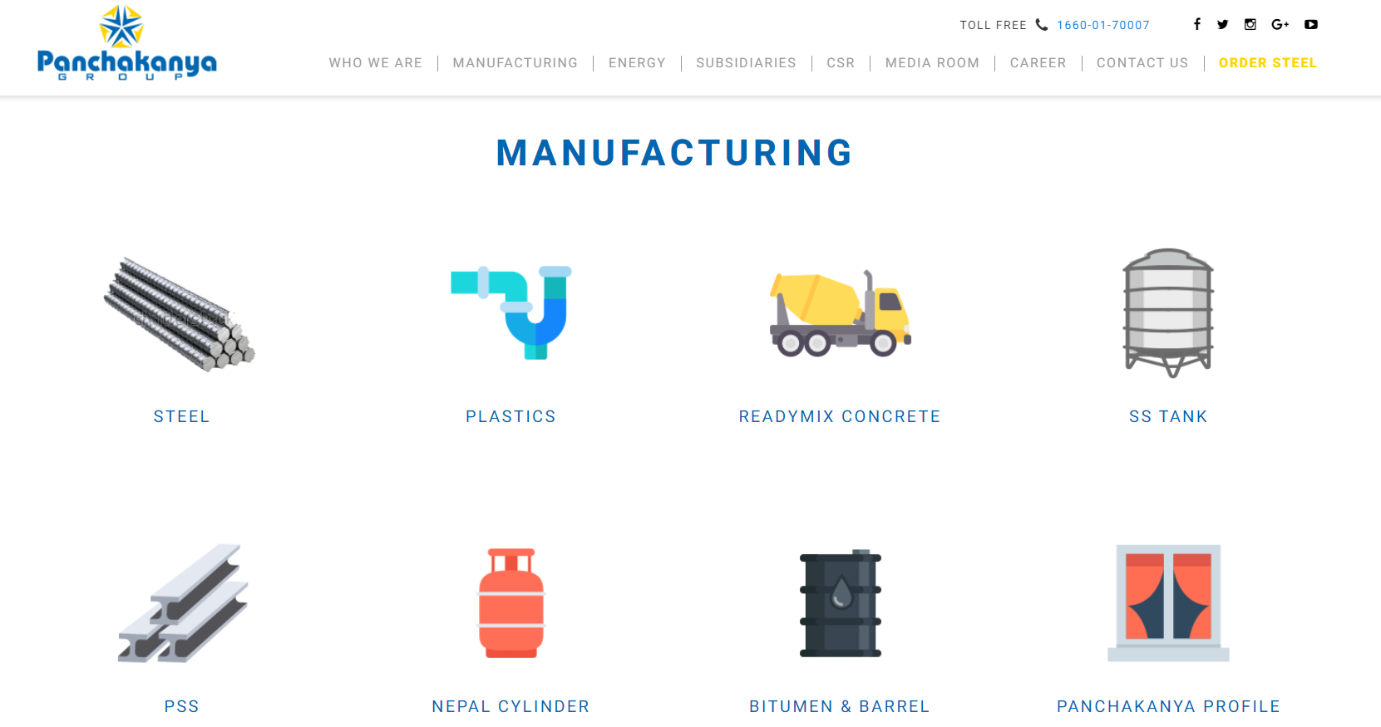

Slide 10

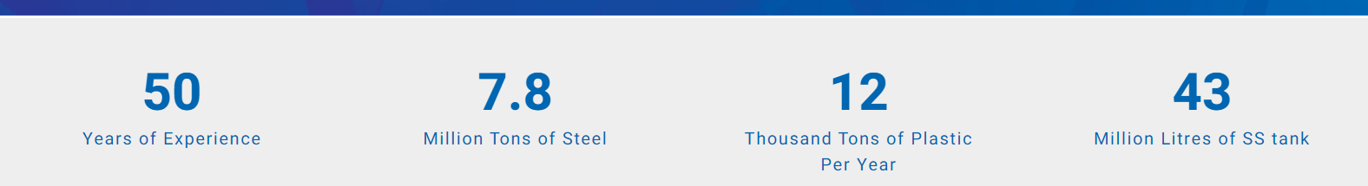
MARKET OVERVIEW

Slide 11
Himalaya Craft
ESTABLISHED IN 2021
FOCUSES ON HIGH-PROFILE CUSTOMER
PRODUCTION FOCUSED ON ORDER
HIGH QUALITY, HIGH PRICE

Slide 12
MARKET COMPARISON
Data Sources
Opportunity to build
Addressable market
→ Industry Visit
Internet
Articles
Journal
Few competitors
Obtainable market

Slide 13

SUMMARY
Growing demand for sustainable and eco-friendly products.
Increasing importance of customization and personalization.
The significant impact of the digital transformation on manufacturing processes.
Opportunities arising from the shift towards servitization and outcome-based models.
The reevaluation of supply chain strategies due to the COVID-19 pandemic, with a trend towards reshoring and localized production for enhanced resilience.

Slide 14

THANK YOU
Prabesh Adhikari
Sandhya K.C.

